Slide 1

Beyond Failing to Reject: A Bayesian Approach to Evaluating the Andilaye WASH Intervention
Yuwei Wang & William Garcia
In-Class Presentation for CSSS 564 Final Project
Jun 3rd, 2026
Photo shot by Lisa Marie Theck in Uganda, obtained via Unsplash
Notes:
Hi everyone, happy last day of the quarter.
My name is Yuwei, and this is my colleague, William. Today we are going to present on our final project, named: Beyond Failing to Reject: A Bayesian Approach to Evaluating the Andilaye WASH Intervention. Our goal today is to show how a Bayesian reanalysis of an existing trial can turn a null result into something more informative. Let's start with the background and what drove us to ask these questions.
10–15 minutes, 10–12 slides.

Slide 2
Background & Research Questions
Andilaye trial — cluster-RCT, rural Amhara, Ethiopia (Delea et al., 2019; Freeman et al., 2022)
The intervention
Demand-side WASH program operating at district, community, group, and household levels community mobilization events, facilitated conversations, and household counseling visits delivered by community change agents to complement Ethiopia’s Health Extension Program.
The gap
GEE (Freeman et al., 2022) and mixed-effects analyses (Yuwei’s prior coursework, 2024) found non-significant effects — but a null p-value can’t separate a truly small effect from an underpowered study. A small effect is also plausible on substantive grounds: a demand-side WASH program is an indirect pathway to mental health.
1
Practical equivalence
What is the posterior probability that the intervention’s effect falls inside a Region of Practical Equivalence (ROPE) around zero for each outcome?
2
Cluster heterogeneity
What is the full posterior distribution of between-kebele variance, and what does it imply about clustering in mental-health outcomes across the 50 kebeles?
Notes:
This project reanalyzes data from the Andilaye trial, a cluster-randomized controlled trial conducted in rural Amhara, Ethiopia. The intervention was a demand-side WASH promotion program that worked across multiple levels, from district down to household, using community change agents to drive behavior change around water, sanitation, and hygiene.
Both the original published analysis using generalized Estimating Equations and my own reanalysis using mixed-effects models found non-significant effects on mental health outcomes. But here's the problem: a non-significant p-value cannot tell us whether the intervention truly had no effect, or whether the study simply lacked the power to detect one. That distinction matters enormously for policy.
So we are asking two questions. First, what is the posterior probability that the intervention's effect falls inside a Region of Practical Equivalence around zero? This lets us make a positive claim about practical null effects rather than just failing to reject. Second, what does the full posterior distribution of between-kebele variance look like? With 50 kebeles in this trial, understanding how much clustering exists in mental health outcomes is a substantive question that frequentist methods only partially address.

Slide 3
Data & Analytic Sample
Endline analytic sample: 1,472 households across 50 kebeles (25 intervention / 25 control)
Anxiety
Depression
Emotional distress
23.5%
15.6%
18.5%
(165 intervention / 181 control)
(105 intervention / 124 control)
(124 intervention / 149 control)
Design
Trial: parallel cluster-RCT; 50 kebeles across 3 woredas (Farta, Fogera, Bahir Dar Zuria)
Treatment: kebele-level random assignment, stratified by woreda
Woreda: fixed covariate (Farta = reference)
Kebele: cluster of randomization → random intercepts
Outcomes & measurement
Instrument: HSCL adaptation (10 anxiety + 13 depression items, 1-4 scale)
Aggregation: household-level mean of eligible members; combined distress across all 23 items
Probable case: mean item score ≥ 1.75 on the 1–4 scale
Missingness: negligible (0.3%); none after household aggregation
Notes:
Our analytic sample comes from the endline wave of the Andilaye trial, covering 1,472 households across all 50 kebeles, split evenly between intervention and control group.
Looking at the three outcomes, anxiety is the most prevalent at 23.5%, followed by emotional distress at 18.5%, and depression at 15.6%. Importantly, in all three cases the control arm has slightly higher prevalence than the intervention arm, which is what motivated the original analyses, but those differences were not statistically significant.
On the design side, this is a parallel cluster-RCT. The unit of randomization is the kebele, and assignment was stratified by woreda. In our model, woreda enters as a fixed covariate with Farta as the reference category, and kebele contributes random intercepts, which is the clustering structure our hierarchical model is built to handle.
For measurement, mental health was assessed using a household-level adaptation of the Hopkins Symptom Checklist, combining 10 anxiety items and 13 depression items on a 1 to 4 scale. We aggregate to the household level by averaging across eligible members, and a probable case is defined as a mean item score of 1.75 or above. Emotional distress combines information across all 23 items.
One practical note: missingness is negligible at 0.3%, and after household-level aggregation, there are no missing values, so we proceed with complete case analysis without any imputation.

Slide 4
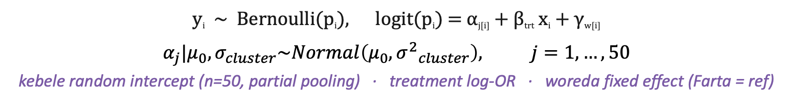
Model Specification
FIT SEPARATELY FOR
Anxiety
Depression
Emotion
BAYESIAN HIERARCHICAL LOGISTIC MODEL
y_{i} ~ Bernoulli(p_{i}), logit(p_{i}) = α_{j[i]} + β_{trt} x_{i} + γ_{w[i]}
$$α_{j}|μ_{0},σ_{cluster}\sim Normal\left(μ_{0}, {σ^{2}}_{cluster}\right), j=1,…, 50$$
kebele random intercept (n=50, partial pooling) · treatment log-OR · woreda fixed effect (Farta = ref)
PRIMARY ESTIMAND OF INTEREST · Average Predictive Difference (APD)
APD = 𝔼_{i} [ Pr(y_{i}=1 | trt=1) − Pr(y_{i}=1 | trt=0) ]
Average difference in predicted caseness probability, integrating over full posterior uncertainty
Reported: posterior mean · 95% HDI · P(|APD| < 0.05) · NNT = 1/|APD|
Notes:
We fit three separate Bayesian hierarchical logistic regression models, one for each outcome: anxiety, depression, and emotional distress.
The model structure is the same across all three. Each household's binary outcome follows a Bernoulli distribution, and we model the log-odds through three components on the linear predictor. The alpha term captures the kebele-level random intercept, giving us partial pooling across all 50 kebeles. The beta-treatment term is our treatment log-odds ratio. And gamma captures the woreda fixed effects, with Farta as the reference category, which mirrors the original trial's design and accounts for the stratified randomization.
Now, rather than reporting the treatment effect purely on the log-odds scale, which is hard to interpret clinically, our primary estimand is the Average Predictive Difference, or APD. This is the average difference in predicted probability between the intervention and control conditions, integrated over the full posterior and over the observed covariate distribution. Concretely, for each posterior draw, we compute the predicted probability of being a probable case under treatment and under control for every household, take the difference, and average across households. That gives us a probability-scale effect size that is directly interpretable.
We report the posterior mean, the 95% Highest Density Interval, the posterior probability that the absolute APD is smaller than 5 percentage points, which is our prespecified Region of Practical Equivalence, and the Number Needed to Treat, which is simply one divided by the absolute APD.

Slide 5
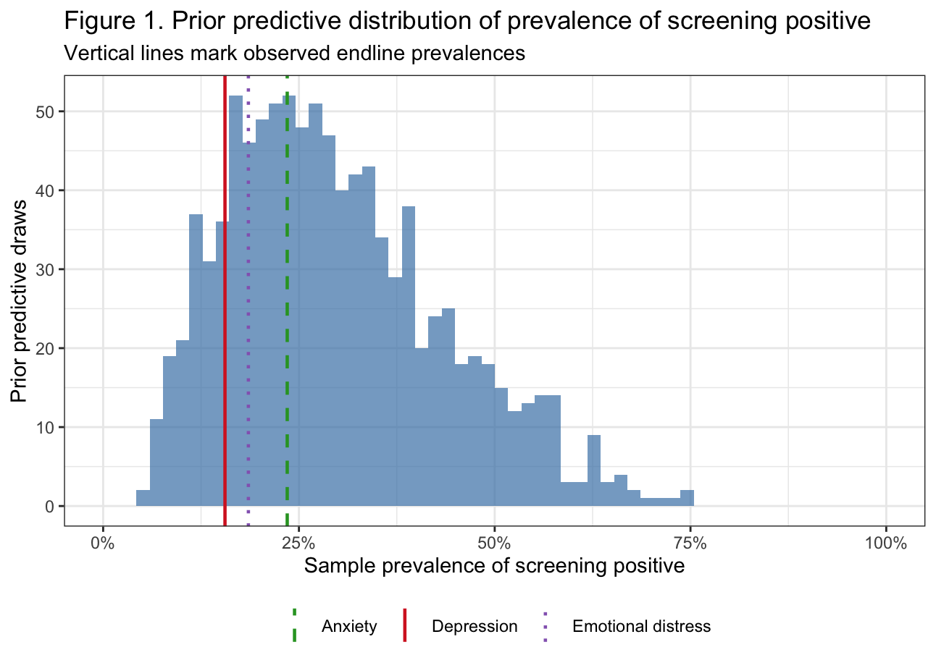
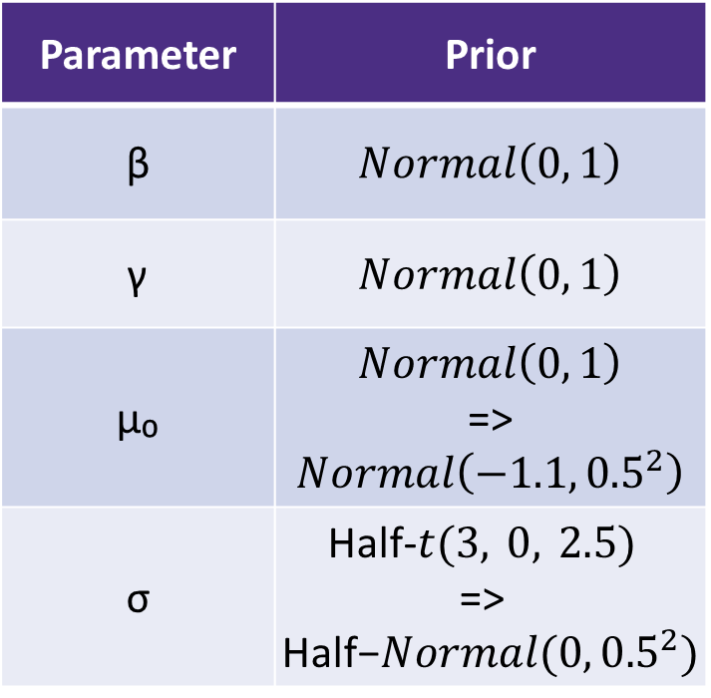
Priors and Prior-Predictive Checks
Prior choices
Prior predictive check
Parameter | Prior
β | $Normal\left(0, 1\right)$
γ | $Normal\left(0, 1\right)$
μ₀ | $Normal\left(0, 1\right)$ => $Normal\left(−1.1, {0.5}^{2}\right)$
σ | Half-$t(3, 0, 2.5)$ => $\text{Half}\text{−}Normal(0, {0.5}^{2})$
Notes:
We started with very weakly informative priors on all the parameters: Normal(0, 1) priors on the treatment coefficient and woreda fixed effects, which on the log-odds scale allows for effects ranging roughly from an odds ratio of 0.1 to 7.
The prior predictive check, however, told us we needed to make two adjustments. The initial Normal(0, 1) on the grand mean intercept mu-zero implied a prior predictive distribution centered around 50% prevalence, which is implausible for mental health screening in this context, where observed prevalences are all below 25%. So we updated mu-zero to a more informative prior, which anchors the prior predictive mass closer to the 10 to 30% range we expect.
Similarly, the initial Half-t prior on the between-kebele standard deviation was generating too much between-cluster heterogeneity. We also tightened it, which keeps cluster-level variation more modest and realistic.
Looking at the final prior predictive distribution on the right, you can see the three vertical lines marking our observed endline prevalences for anxiety, depression, and emotional distress, all sitting comfortably within the bulk of the prior predictive mass. This tells us the priors are weakly informative in the right direction.

Slide 6
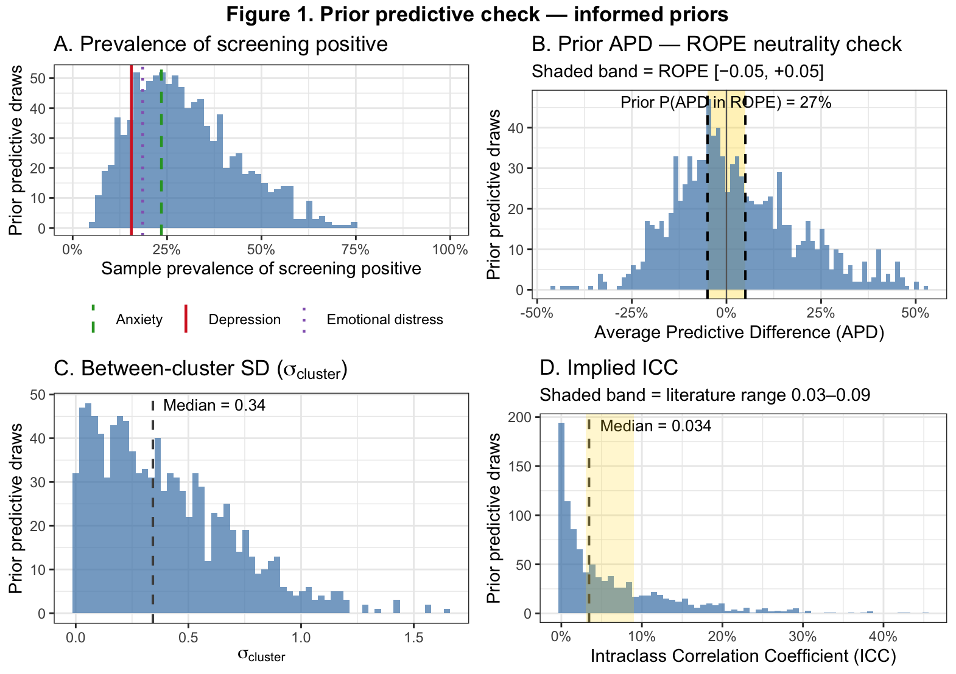
More Figures on Prior-Predictive Checks

Slide 7
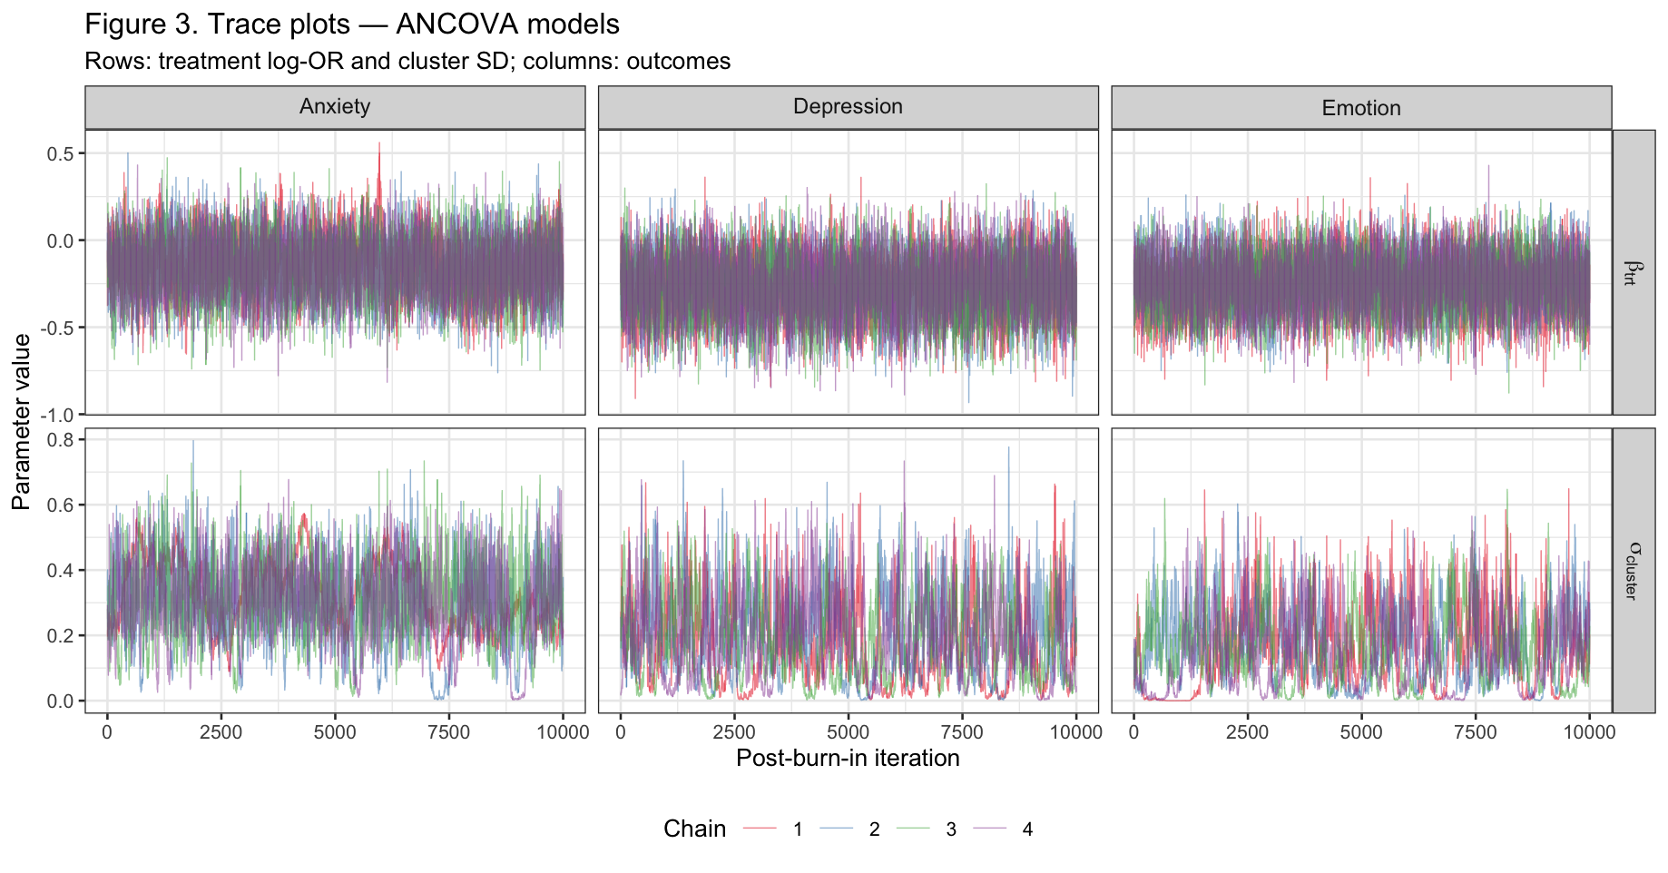
Model fitting
Software & setup
Fit in R using JAGS via rjags
Gibbs sampling
4 independent chains
Burn-in: 10,000 iterations (discarded)
Post burn-in: 20,000 iterations, thinned by 2
10,000 draws / chain → 40,000 total per model
LOO comparison: specified model vs. specified model + baseline score (ANCOVA)
  ANCOVA is preferred and reported!
Notes:
All three models were fit in R using JAGS via the rjags package, running Gibbs sampling with 4 independent chains. We discarded the first 10,000 iterations as burn-in, then collected 20,000 post-burn-in iterations thinned by 2, giving us 10,000 draws per chain and 40,000 total posterior samples per model. We compared this primary model with a version adding baseline score as a covariate using LOO, and we actually preferred ANCOVA models. This makes sense because conditioning on baseline mental health scores absorbs a large share of individual-level variance, sharpening our estimate of the treatment effect without changing the model's causal interpretation. All results from this point forward are from the ANCOVA models.
The trace plots on the right give us a first visual check of convergence. Each row shows a different parameter: the top row is the treatment log-odds ratio, and the bottom row is the between-kebele standard deviation sigma. Columns correspond to our three outcomes. What we want to see are "fuzzy caterpillars”. The top row about beta looks fine. But the bottom row for sigma is a bit more ragged. this is the funnel problem we discussed in class. We can see that sigma drifts near zero, the posterior geometry narrows into a funnel that is hard for the sampler to navigate, producing the spiky behavior you see here, especially for depression and emotional distress.

Slide 8
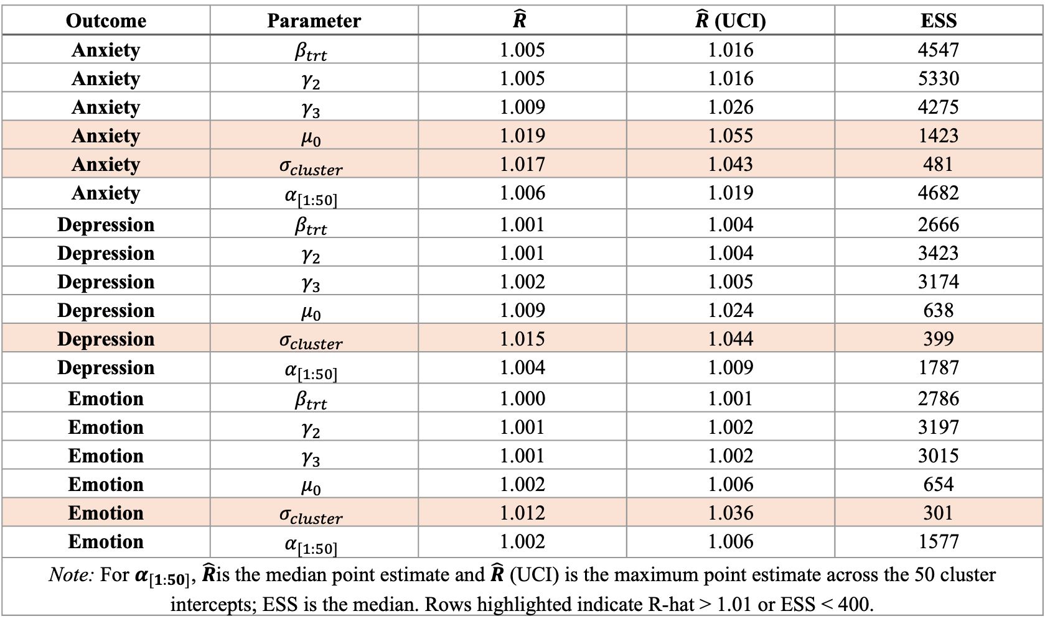
Diagnostics (1)
Outcome | Parameter | $$\hat{R}$$ | $\hat{R}$ (UCI) | ESS
Anxiety | $$β_{trt}$$ | 1.005 | 1.016 | 4547
Anxiety | $$γ_{2}$$ | 1.005 | 1.016 | 5330
Anxiety | $$γ_{3}$$ | 1.009 | 1.026 | 4275
Anxiety | $$μ_{0}$$ | 1.019 | 1.055 | 1423
Anxiety | $$σ_{cluster}$$ | 1.017 | 1.043 | 481
Anxiety | $$α_{[1:50]}$$ | 1.006 | 1.019 | 4682
Depression | $$β_{trt}$$ | 1.001 | 1.004 | 2666
Depression | $$γ_{2}$$ | 1.001 | 1.004 | 3423
Depression | $$γ_{3}$$ | 1.002 | 1.005 | 3174
Depression | $$μ_{0}$$ | 1.009 | 1.024 | 638
Depression | $$σ_{cluster}$$ | 1.015 | 1.044 | 399
Depression | $$α_{[1:50]}$$ | 1.004 | 1.009 | 1787
Emotion | $$β_{trt}$$ | 1.000 | 1.001 | 2786
Emotion | $$γ_{2}$$ | 1.001 | 1.002 | 3197
Emotion | $$γ_{3}$$ | 1.001 | 1.002 | 3015
Emotion | $$μ_{0}$$ | 1.002 | 1.006 | 654
Emotion | $$σ_{cluster}$$ | 1.012 | 1.036 | 301
Emotion | $$α_{[1:50]}$$ | 1.002 | 1.006 | 1577
Note: For $α_{[1:50]}$, $\hat{R}$is the median point estimate and $\hat{R}$ (UCI) is the maximum point estimate across the 50 cluster intercepts; ESS is the median. Rows highlighted indicate R-hat > 1.01 or ESS < 400.
Notes:
So these are our formal convergence numbers for the ANCOVA models. We can see that $β_{\text{trt}}$looks good across all three outcomes — ESS well above 2,000, R-hat well behaved. $μ_{0}$for anxiety is just nudging above the 1.01 threshold on R hat, and $σ_{\text{cluster}}$for emotion has ESS of 301, below our 400 threshold. Same funnel story as before, nothing that changes our conclusions about the treatment effect.

Slide 9
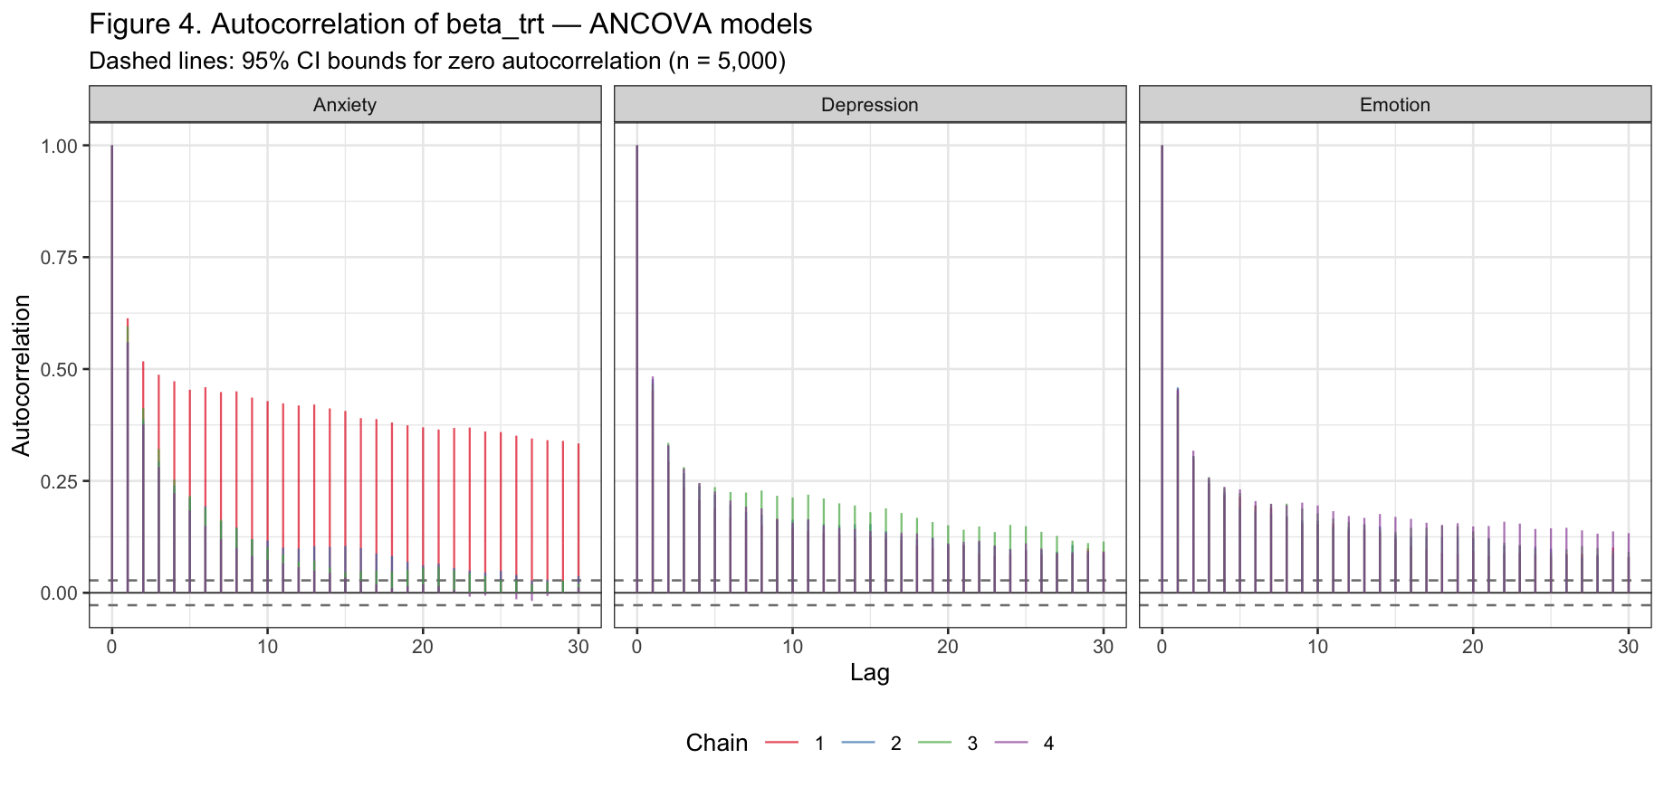
Diagnostics (2)
Notes:
This one is a bit embarrassing honestly. We want those bars to drop to zero quickly — they do not. The autocorrelation hangs around well past lag 30, meaning our draws are not as independent as we would like even after thinning. This is a known weakness of Gibbs sampling in hierarchical models and we are acknowledging it as a limitation.

Slide 10
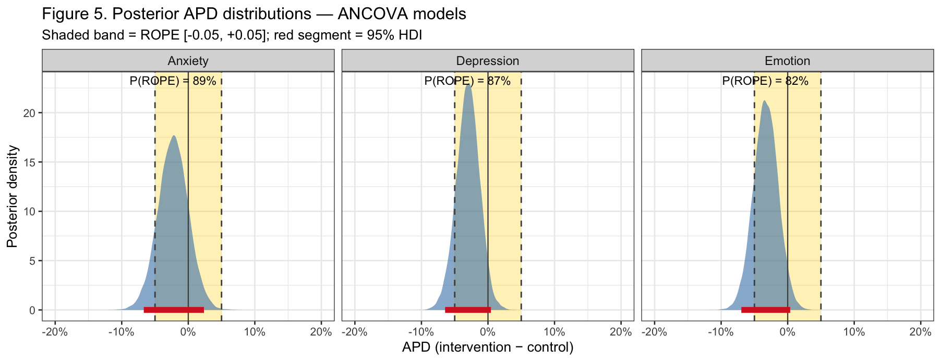
Findings (1): APD
Bottom line
Evidence favors a practically small effect, but does not meet our 95% ROPE threshold for declaring practical equivalence. The data are more consistent with a practically plausible negligible effect than with a large one (unlikely).
Notes:
So this is the main result. Figure 5 shows the posterior distributions of the Average Predictive Difference for all three outcomes under the ANCOVA model. Remember the APD is the average difference in predicted probability of screening positive between intervention and control households, averaged over all 1,468 households in the sample.
A few things to notice. First, all three posteriors are centered just to the left of zero — so there is a slight tendency toward lower screening-positive probability in the intervention arm, but it is very small. Second, and more importantly, the shaded gold band is our ROPE — the region of practical equivalence between minus 5 and plus 5 percentage points. The posterior probability inside the ROPE is 89% for anxiety, 87% for depression, and 82% for emotional distress. None of these cross the 95% threshold for what we would call strong evidence of a null effect, but all three are well above 50%, meaning the data are substantially more consistent with no meaningful effect than with a practically important one. The red segments at the bottom are the 95% HDIs — all of them straddle zero and sit mostly within the ROPE. The NNT ranges from 30 to 44 households, which is far too large to be actionable for a community-scale intervention.
Bottom line: the Andilaye WASH intervention did not move the needle on women's mental health in any practically meaningful way.

Slide 11
More on model comparison

Slide 12
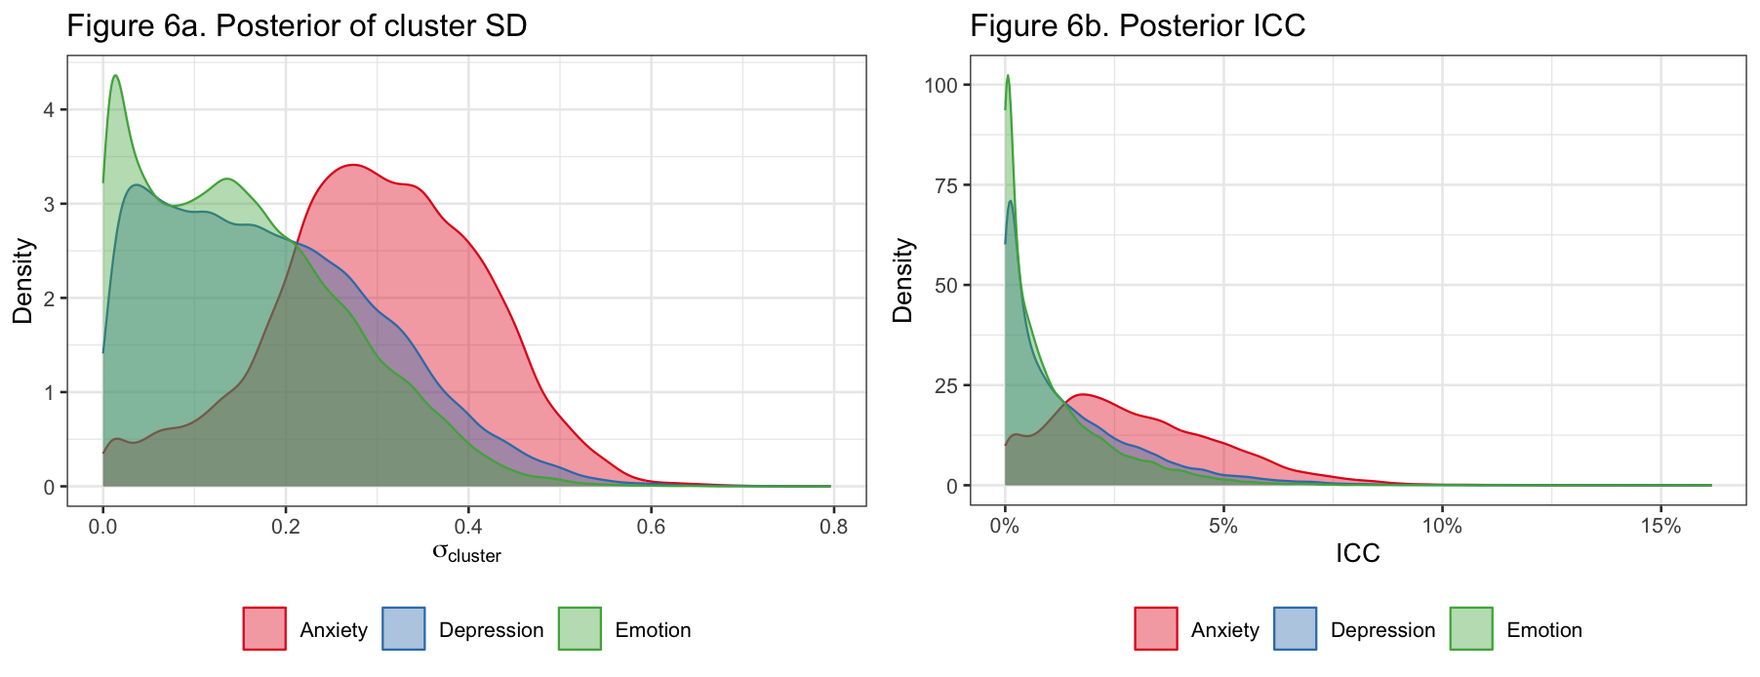
Findings (2): Between-Cluster Variance
Notes:
Figure 6 shows the posterior distributions of the between-kebele standard deviation and the implied ICC. This is the second part of our research question — what does the clustering structure look like?
Figure 6a shows $σ_{\text{cluster}}$for each outcome. All three distributions are right-skewed and concentrated near modest values, with anxiety showing the most heterogeneity and emotional distress the least. But notice how wide these distributions are — the HDIs all extend close to zero, meaning the data are consistent with very little between-kebele clustering at all.
Figure 6b translates this into ICC, which is arguably more interpretable. The posterior means are 0.030 for anxiety, 0.014 for depression, and 0.011 for emotional distress — all at or below the lower boundary of what the literature reports for mental health outcomes in similar trials. What this tells us is that mental health in this population varies mostly between households, not between communities. Kebele membership does not tell you much about a woman's mental health status. And this is actually one of the key things a Bayesian hierarchical model gives us that GEE cannot — not just a point estimate of clustering, but a full posterior distribution that honestly quantifies how uncertain we are about it.

Slide 13
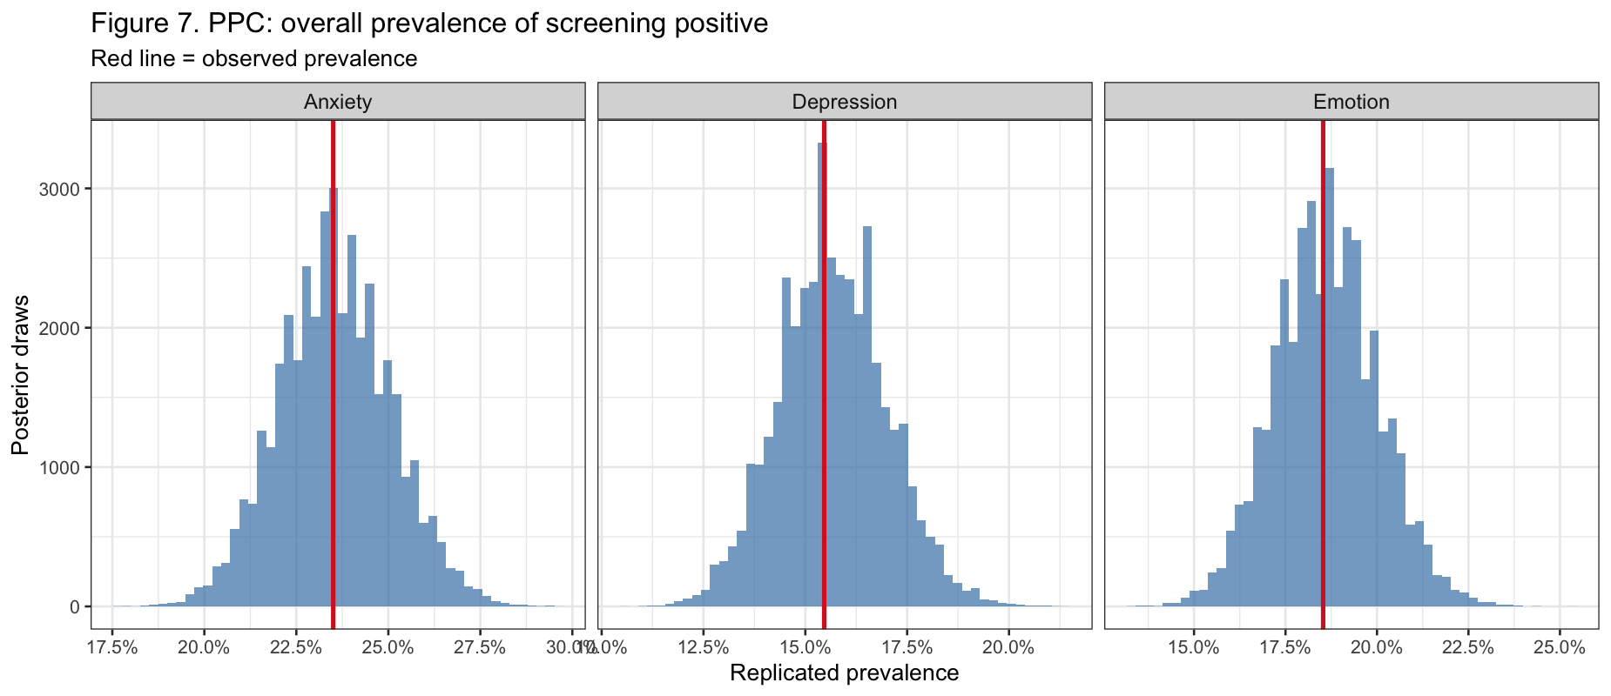
Posterior Predictive Check
Notes:
1.5 min
at
least one figure

Slide 14
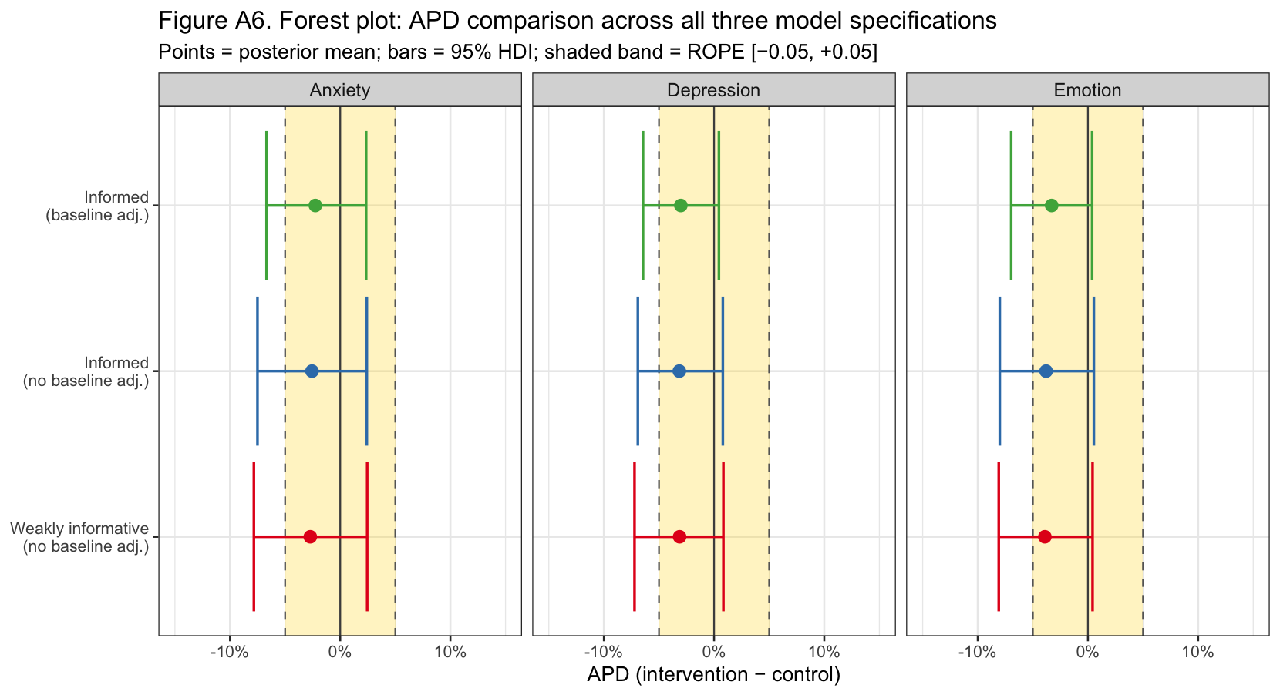
Caveats and Sensitivity
Notes:
So far we have shown you the model, the diagnostics, and the main results. A natural question at this point is: how much should we trust those results? Do they depend on the choices we made along the way — the priors, the model specification, whether we adjust for baseline? That is what this slide addresses.
The forest plot shows APD estimates and 95% HDIs across all three model specifications: the weakly informative prior model without baseline adjustment, the informed prior model without baseline adjustment, and our primary ANCOVA model with baseline adjustment and informed priors. A few things jump out immediately. First, all three models tell essentially the same story — small negative APDs, HDIs straddling zero, large majority of posterior mass inside the ROPE across all three outcomes. Second, the ANCOVA model gives slightly tighter intervals as expected from conditioning on baseline, but it does not shift the point estimates meaningfully. Third, the prior choice makes virtually no difference — the weakly informative and informed prior models are nearly indistinguishable in this plot.
The LOO comparison confirmed ANCOVA as the preferred model, but as you can see here, that choice was not load-bearing for the conclusion. The answer is in the data, not in our modeling decisions. With that, let me move to the final slide.

Slide 15
Future Directions
If we had another quarter…
1
2
3
Refit in Stan via brms
Three-level model
Varying-slopes by woreda
Refit current models in Stan via brms (HMC instead of Gibbs).
Extend to a three-level model treating woredas as a random level rather than fixed effects.
Fit a varying-slopes model — treatment effect free to differ across woredas.
Notes:
If we had another quarter, three things. First, refit in Stan using brms — this might fix the autocorrelation and mixing issues we saw in the diagnostics essentially for free. Second, extend to a three-level model that properly treats woredas as a random level rather than fixed effects, which would give us a full posterior for woreda-level heterogeneity and better reflect the nested design. Third, fit a varying-slopes model allowing the treatment effect to differ across woredas — given the documented variation in intervention fidelity across sites, it is plausible that the intervention worked better in some woredas than others, and that heterogeneity is currently hidden inside a single beta. All three are natural extensions of exactly what we built here, just one level more complex.

Slide 16
Summary
What this Bayesian reanalysis actually tells us
1
2
3
A large effect is unlikely
But not “no effect”
A more useful answer
Most posterior mass sits inside the plus-or-minus 5-point ROPE for all three outcomes. A large, programmatically meaningful effect is implausible.
Posterior mass inside the ROPE (89% / 87% / 82%) does not reach our 95% threshold. A small benefit remains plausible.
Rather than proving the null, we quantify how much posterior probability lies in a policy-relevant region around zero.

Slide 17
References
Delea, M. G., Snyder, J. S., Belew, M., Caruso, B. A., Garn, J. V., Sclar, G. D., Woreta, M., Zewudie, K., Gebremariam, A., & Freeman, M. C. (2019). Design of a parallel cluster-randomized trial assessing the impact of a demand-side sanitation and hygiene intervention on sustained behavior change and mental well-being in rural and peri-urban Amhara, Ethiopia: Andilaye study protocol. BMC Public Health, 19(1), 801. https://doi.org/10.1186/s12889-019-7040-6
Freeman, M. C., Delea, M. G., Snyder, J. S., Garn, J. V., Belew, M., Caruso, B. A., Clasen, T. F., Sclar, G. D., Tesfaye, Y., Woreta, M., Zewudie, K., & Gobezayehu, A. G. (2022). The impact of a demand-side sanitation and hygiene promotion intervention on sustained behavior change and health in Amhara, Ethiopia: A cluster-randomized trial. PLOS Global Public Health, 2(1), e0000056. https://doi.org/10.1371/journal.pgph.0000056

